Slide 1
Capstone Project – 4 Unsupervised ML
"Netflix Movies and TV Shows Clustering" Presented By : Mr. Hasnain Mazhar Rizvi

Slide 2
Points of Discussion
Problem Statement
Data Description
Data Preparation and Cleaning
EDA (Exploratory Data Analysis)
Hypothesis Testing
Textual Data Preprocessing
Dimensionality Reduction
Model Implementation
Recommender System
Conclusion

Slide 3
1. Problem Statement
This dataset consists of tv shows and movies available on Netflix as of 2019. The dataset is collected from Flixable which is a third-party Netflix search engine.
In 2018, they released an interesting report which shows that the number of TV shows on Netflix has nearly tripled since 2010. The streaming service’s number of movies has decreased by more than 2,000 titles since 2010, while its number of TV shows has nearly tripled. It will be interesting to explore what all other insights can be obtained from the same dataset.
In this project, required to do:
Exploratory Data Analysis.
Understanding what type content is available in different countries.
Is Netflix has increasingly focusing on TV rather than movies in recent years.
Clustering similar content by matching text-based features.

Slide 4
2. Data Description
The dataset contains movies and tv shows information like title, cast, director, release year, rating, duration etc.
The features of the dataset are :
show_id: Unique Id number for all the listed rows
type: denotes type of show namely TV Show or Movie
title: title of the movie
director: Name of director/directors
cast: lists the cast of the movie
country: country of the production house
date_added: the date the show was added
release_year: year of the release of the show
rating: show ratings
duration: duration of the show
listed_in: the genre of the show
description: summary/ description of the movie

Slide 5

3. EDA (Exploratory Data Analysis)

Slide 6
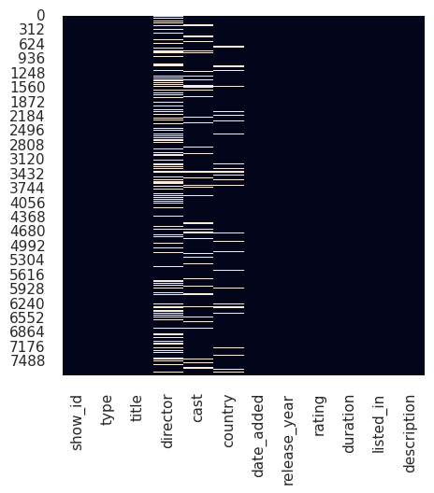
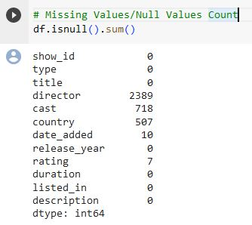
Missing Values

Slide 7
4. Data Preparation and Cleaning
To make the data analysis ready i have done the following:
Filled missing values of cast with Not available.
Filled missing values of country with Not Known.
Dropped rows of date_added missing values.
Dropped rows of ratings missing values.
Dropped the entire column of director as it had much number of missing values, we can not do that so we replaced the null values of director with Unknown.

Slide 8
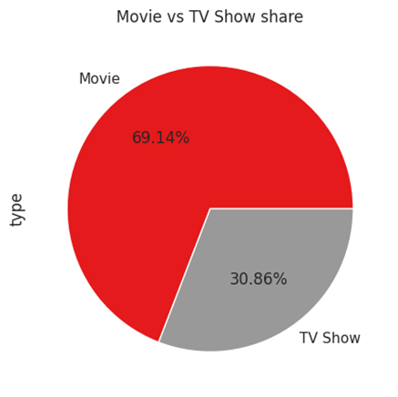
MOVIE VS TV SHOW SHARE
Types of shows available in Netflix is not even with high count for TV shows.
69.14% of the data belongs to Movies and 30.86% of the data for TV shows.

Slide 9
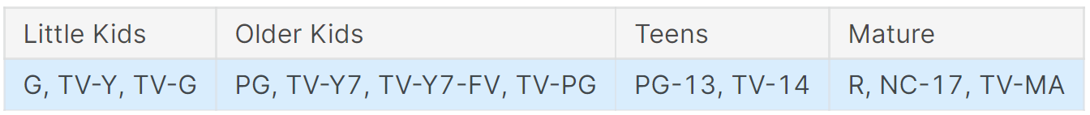
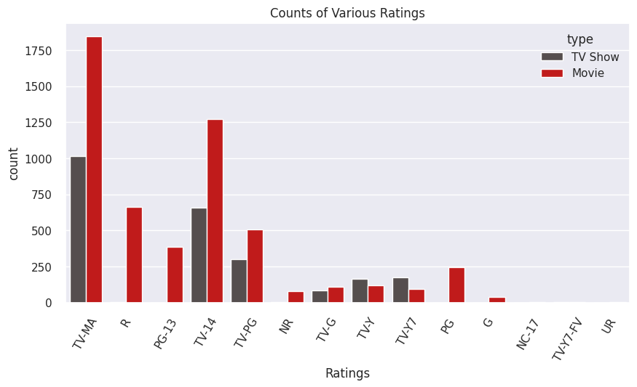
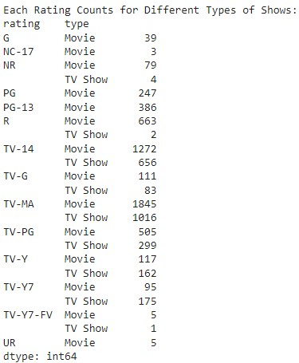
VARIOUS RATINGS COUNT
TV-MA tops the charts, indicating that mature content is more popular on Netflix.
This popularity is followed by TV-14 and TV-PG, which are Shows focused on Teens and Older kids.
Very few titles with a rating NC-17 exist. It can be understood since this type of content is purely for the audience above 17.

Slide 10
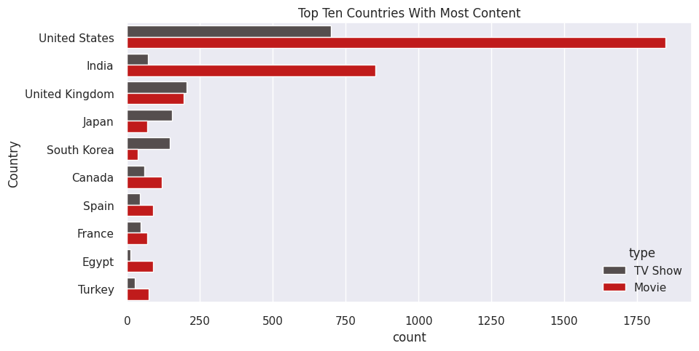
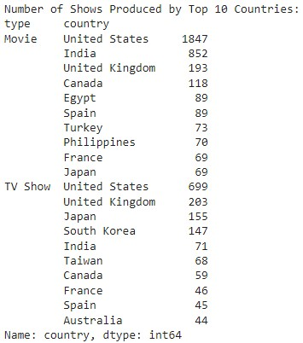
TOP 10 COUNTRIES WITH MOST CONTENT
The United States is a leading producer of both types of shows (Movies and TV Shows), this makes sense since Netflix is a US company.
The influence of Bollywood in India explains the type of content available, and perhaps the main focus of this industry is Movies and not TV Shows.
TV Shows are more frequent in South Korea, which explains the KDrama culture nowadays.

Slide 11
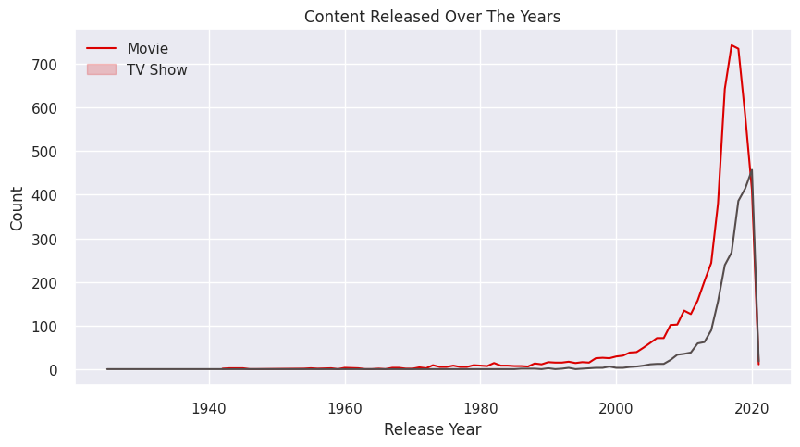
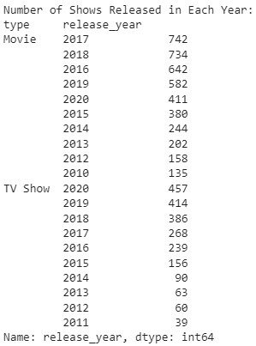
CONTENT RELEASED OVER THE YEARS
Growth in the number of movies on Netflix is much higher than tv shows.
Most of the content available was released between 2010 and 2020.
Highest number of movies got released in 2017 & 2018 and tv shows got released in 2019 & 2020.
Very few movies, and tv shows got released before the year 2010 and in 2021. It is due to very little data collected from the year 2021.

Slide 12
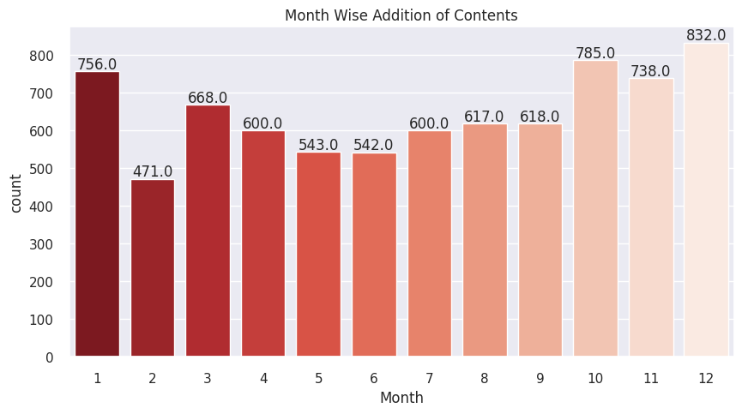
CONTENT ADDED OVER THE MONTHS
October, November, December, and January are months in which many tv shows and movies get uploaded to the platform.
It might be due to the winter, as in these months people may stay at home and watch tv shows and movies in their free time.

Slide 13
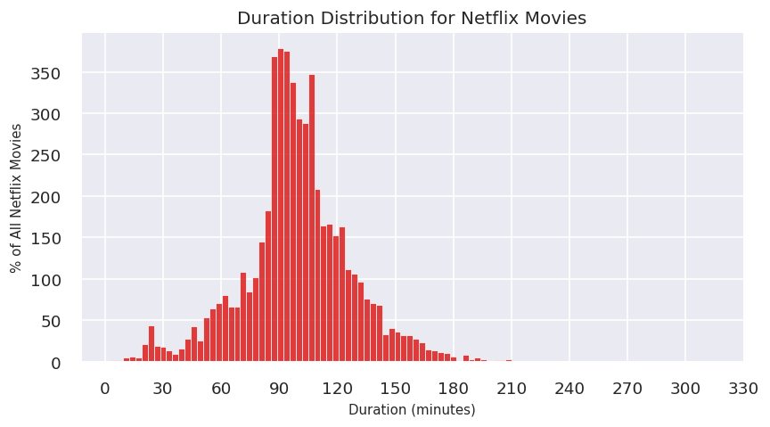
NETFLIX MOVIES DURATION
Most number of movies on the Netflix platform are last for 90 to 120 minutes.
Very few movies are of length more than 200 minutes.

Slide 14
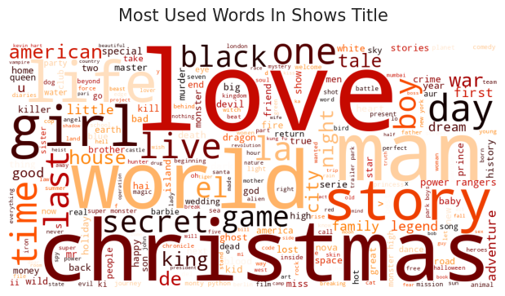
MOST USED WORDS IN SHOWS TITLE
Most repeated words in title include Christmas, Love, World, Man, and Story.
We saw that most of the movies and tv shows got added during the winters, which tells why Christmas appeared many times in the titles.

Slide 15
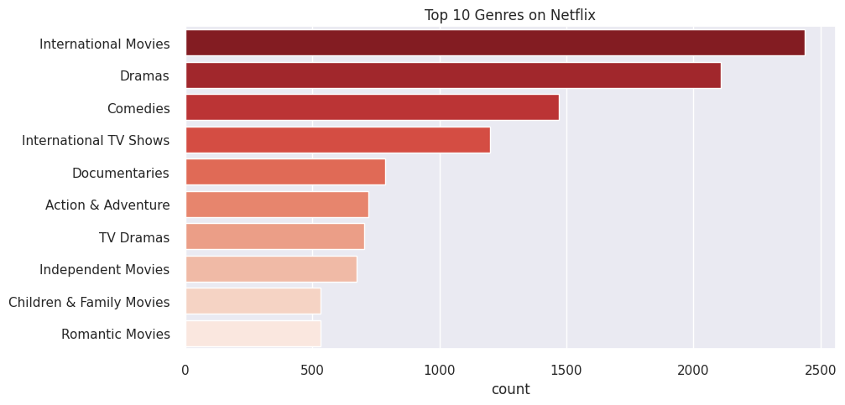
TOP 10 GENRES
In terms of genres, international movies takes the cake surprisingly followed by dramas and comedies.
Even though the United States has the most content available, it looks like Netflix has decided to release a ton of international movies.

Slide 16
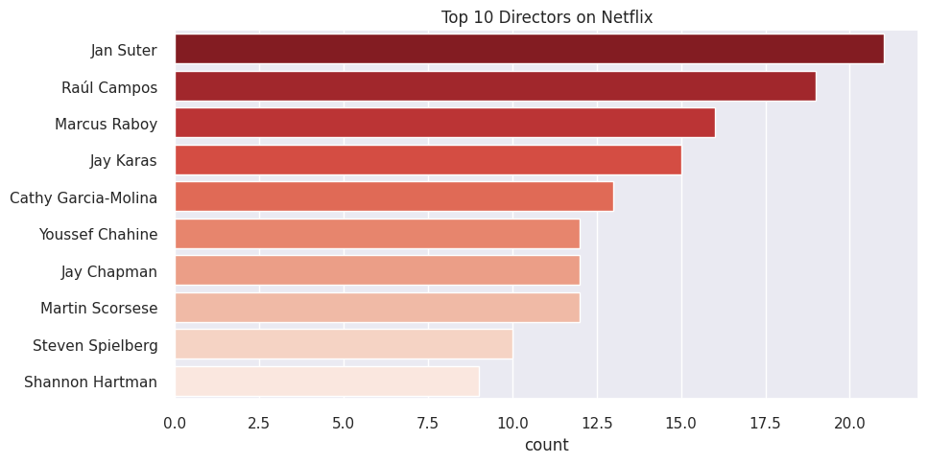
TOP 10 DIRECTORS
Jan Suter, Raúl Campos, Marcus Raboy, Jay Karas, Cathy Garcia-Molina are the top 5 directors which highest number of movies and tv shows are available in netflix.
As we stated previously regarding the top genres, it's no surprise that the most popular directors on Netflix with the most titles are mainly international as well.

Slide 17
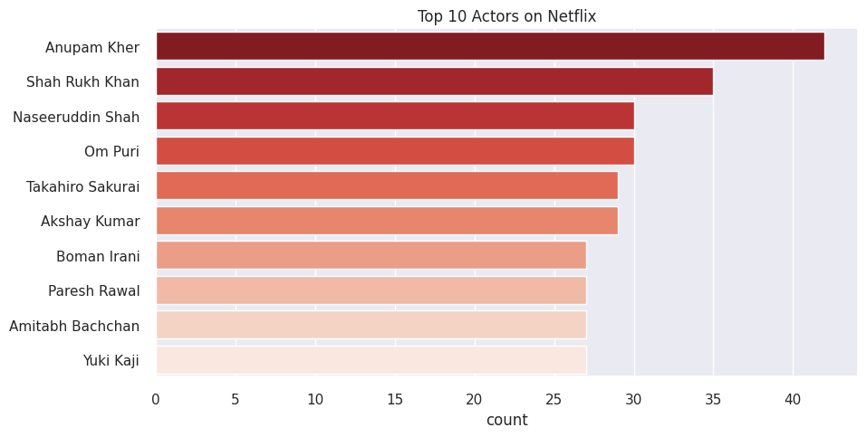
TOP 10 ACTORS
The actors in the top ten list of most numbers tv shows and movies are from India.
Anupam Kher and Shah Rukh Khan have 30 above content alone in netflix.

Slide 18
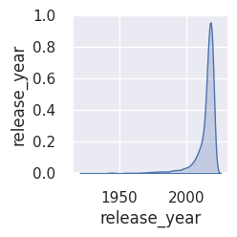
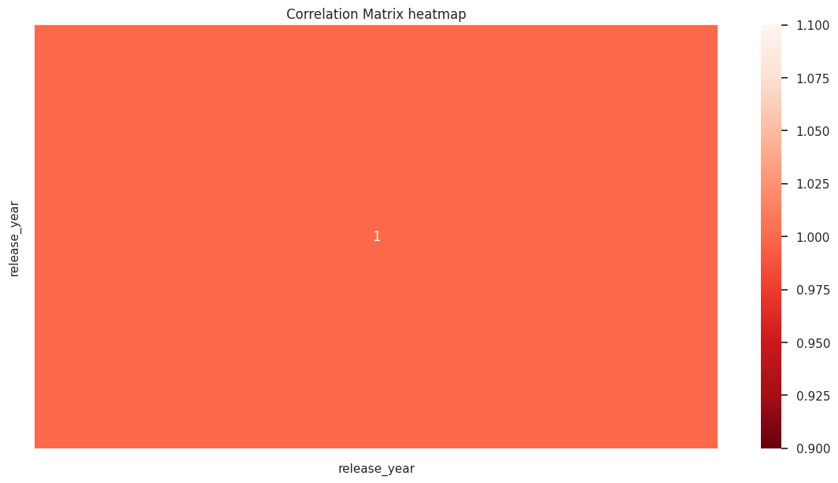
CORRELATION HEATMAP & PAIR PLOT
Since there is only one value in dataframe of integer type, we are unable to visualize the correlation matrix heatmap and pair plot as well.

Slide 19
5. Hypothesis Testing

Slide 20

HYPOTHESIS TESTING - 1
AVERAGE NUMBER OF MOVIES ON NETFLIX IN UNITED STATES IS HIGHER THAN THE MOVIES ON NETFLIX IN INDIA
I selected the two-sample t-test for this analysis as it is suitable for comparing the means of two independent samples.
By applying this test, I was able to calculate the p-value and determine if there is a significant difference in the number of movies between the two countries.

Slide 21

HYPOTHESIS TESTING - 2
NUMBER OF MOVIES AVAILABLE ON NETFLIX IS GREATER THAN THE NUMBER OF TV SHOWS AVAILABLE ON NETFLIX
The two sample z-test is used to determine if there is a significant difference between two categorical variables.
In this case, I wanted to test if there was a significant difference between the number of movies and tv shows available on Netflix.

Slide 22
6. TEXTUAL DATA PREPROCESSING
Transforming text into a clean and consistent form

Slide 23
WORK PROCESS
1. TOKENIZATION
Replacing sensitive data with unique identification symbols
2. TEXT REMOVAL
Removing punctuation, numbers, stop words etc.
3. STEMMING
Reducing words to their base form (root form)
4. LEMMATIZATION
Grouping together words with their root form
5. POS TAGGING
Process of finding the sequence of tags

Slide 24
7. DIMENSIONALITY REDUCTION
Reducing the feature set’s dimension

Slide 25
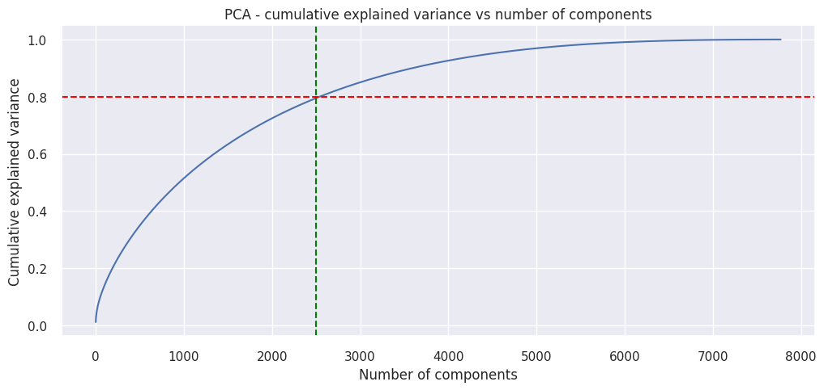
DIMENSIONALITY REDUCTION
Principal Component Analysis (PCA) was used to reduce the dimensionality of data.
Captured more than 80% of the variance by reducing the components to 2500.

Slide 26
8. MODEL IMPLEMENTATION
Train ML Algorithms to get best model

Slide 27
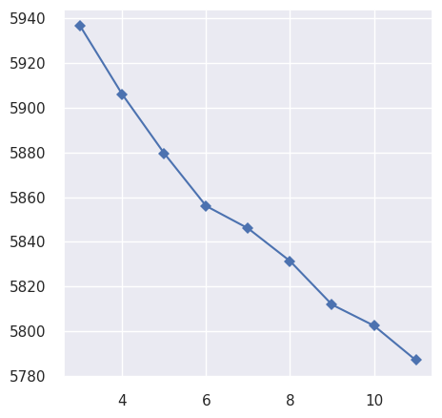
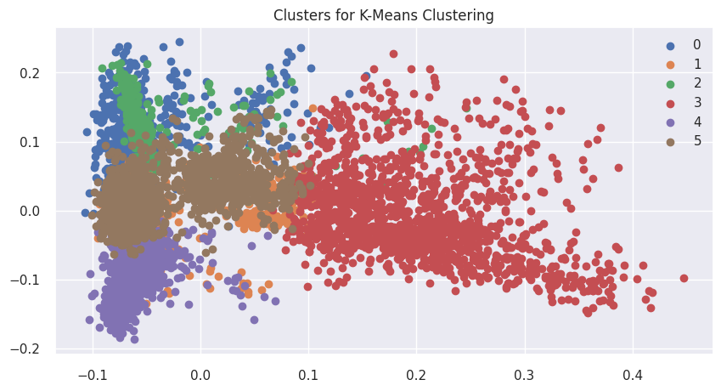
K-MEANS CLUSTERING
K-means is a centroid-based clustering algorithm, where we calculate the distance between each data point and a centroid to assign it to a cluster.
Here optimal number of clusters is 6 by using the elbow method.

Slide 28
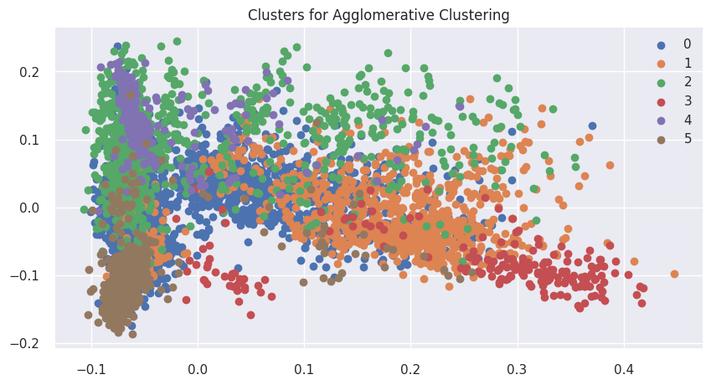
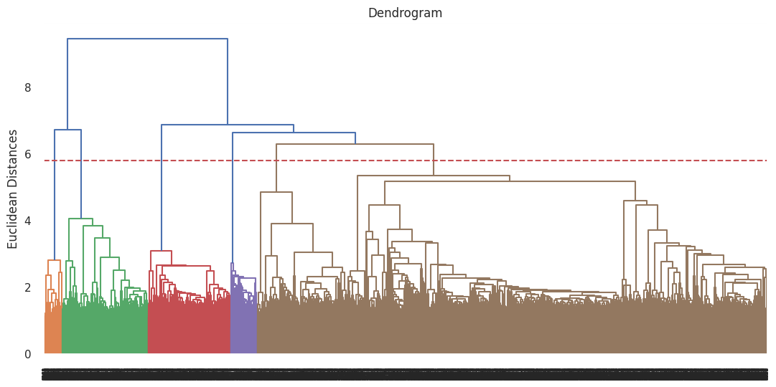
HIERARCHICAL CLUSTERING
From dendrogram we get the optimal number of clusters is 6.
Used agglomerative clustering here, which is a type of hierarchical clustering algorithm. It helps us to divides the population into several clusters.

Slide 29
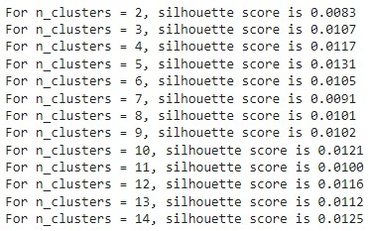
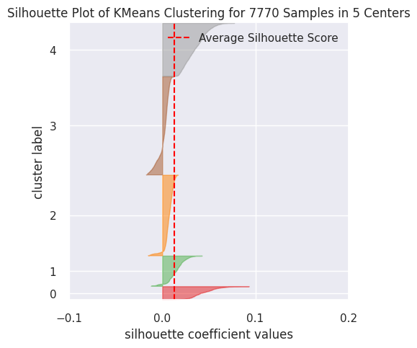
SILHOUETTE SCORE FOR CLUSTERING
Silhouette score is highest for the cluster 5, so the optimal number of clusters will be 5.
Silhouette score is a metric used to calculate the goodness of a clustering technique. Its value ranges from -1 to 1.

Slide 30
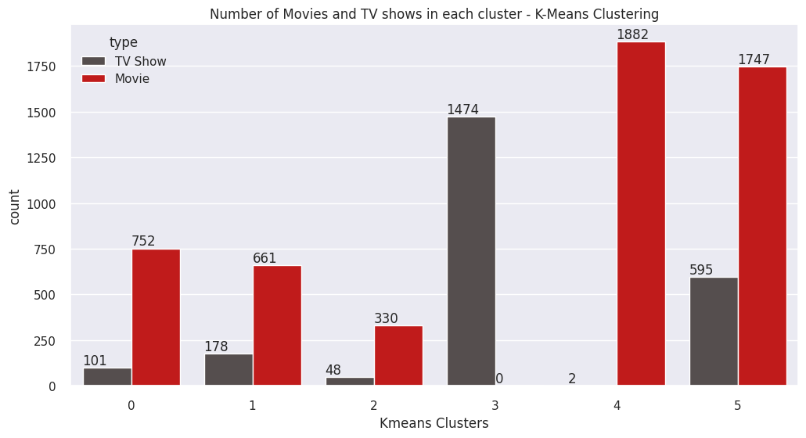
FINAL PREDICTION MODEL
Selected K-Mean Clustering model as the best model for our data.
The clusters are well divided in this model and through this cluster we can know what type of data is in which cluster.

Slide 31
TOPIC MODELING
Used topic modeling instead of feature importance and model explainability.
We can get topic wise feature importance. Assume that the clusters are topics.
Used CountVectorizer process for Vectorization of data and Latent Dirichlet Allocation for building a topic.

Slide 32
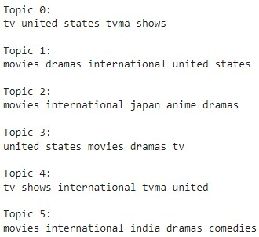
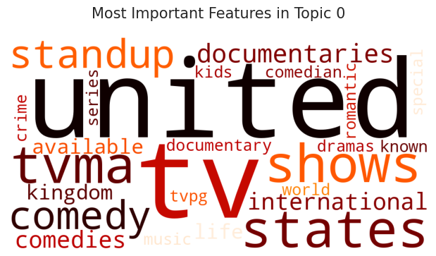
TOPIC MODELING
The most important features, which we are get from each topics:

Slide 33
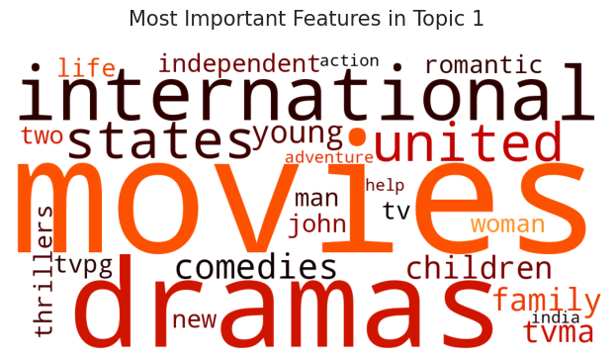
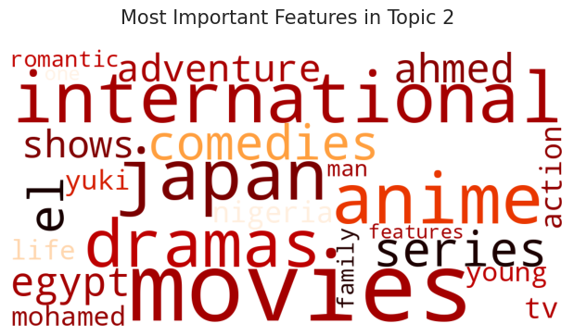
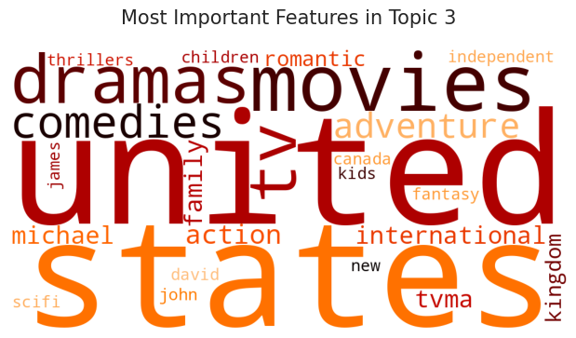
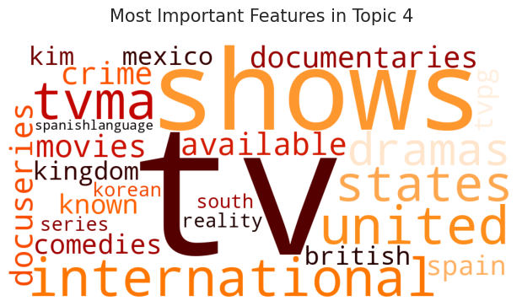
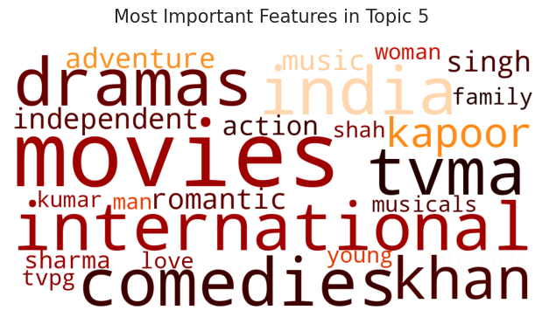
WORDCLOUD FOR OTHER TOPICS

Slide 34
RECOMMENDER SYSTEM

Slide 35
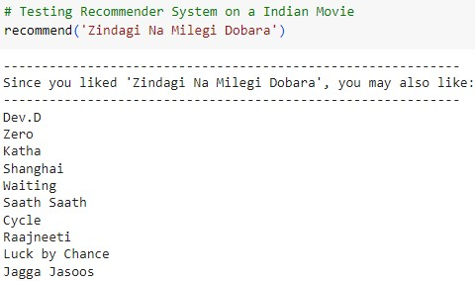
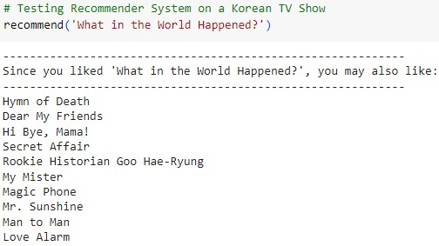
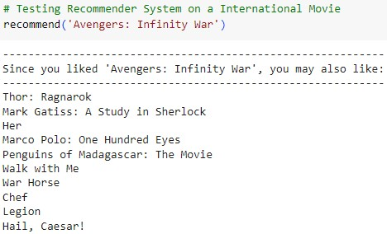

TOP 10 RECOMMENDED MOVIES/ TV SHOWS
Content-based recommender system on the basis of cosine similarity score.

Slide 36
Conclusion
Analysis revealed that Netflix has a greater number of movies than TV shows.
Clustering TV shows and movies based on their similarities and differences, created a content-based recommender system that recommends top 10 shows to users based on their viewing history.

Slide 37
Thank You AlmaBetter!!!

